Slide 1
Presented By Group-C, Batch-97.
LIBRARY
MANAGEMENT
SYSTEM

Slide 2

TEAM MEMBERS
SAMEENA NADAF
JAFFAR SADIQ
SHIVAPPA TALUR
SHIVAKVMAR NEELA
HEMANTH HARISH

Slide 3
CONTENTS
Problem statement
2. Overview
3. Design
4. Technologies used
5. Results

Slide 4

PROBLEM STATEMENT
We can keep the record of the books took by the students.
The problem faced in the library is that keeping the data of the students in library is very difficult when there are a greater number of students. To overcome this problem, we can use the database which is easier and secure.
Admin can easily add and remove the books in library and can also view the data of students.

Slide 5
OVERVIEW
Library Management System is used to maintain the details of students themselves in their respective college by using the online registration form, can also login by using their own login id and password of existed students, so that the student can access their profile . Admin can login by their own credentials to check and view the books available in library.

Slide 6
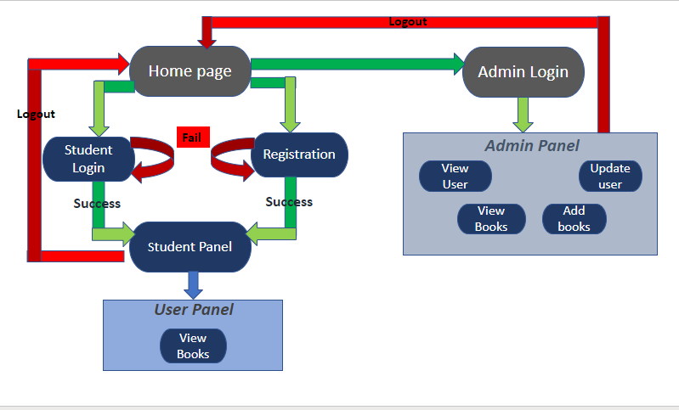
DESIGN

Slide 7
TECHNOLOGIES USED
FRONT-END:
HTML
BACK-END:
JAVA
DATABASE:
MY-SQL
FRAME WORK:
SPRING MVC
CSS

Slide 8


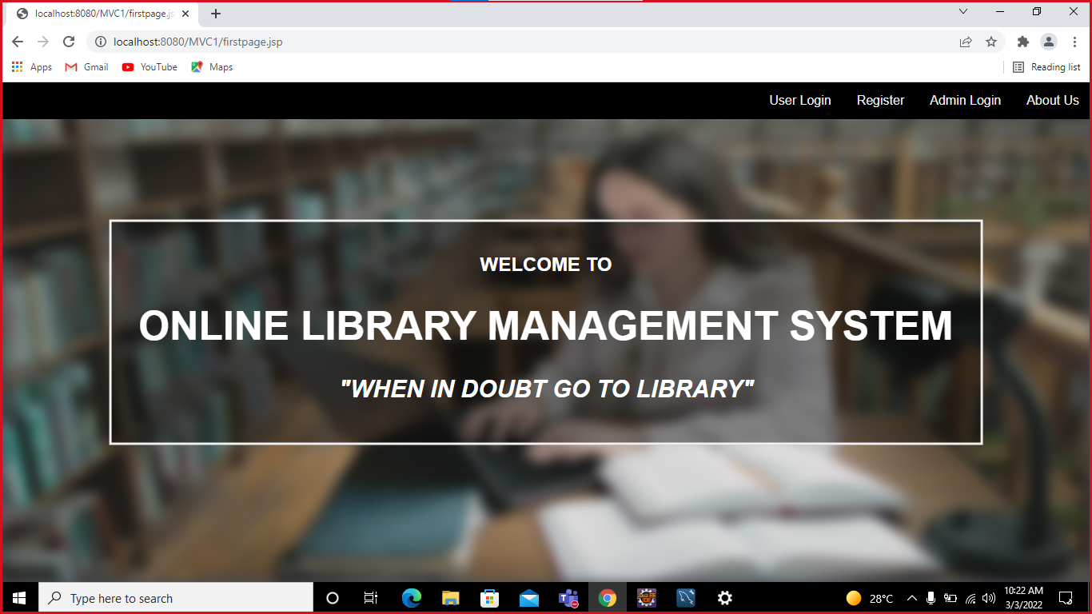


HOME PAGE

Slide 9
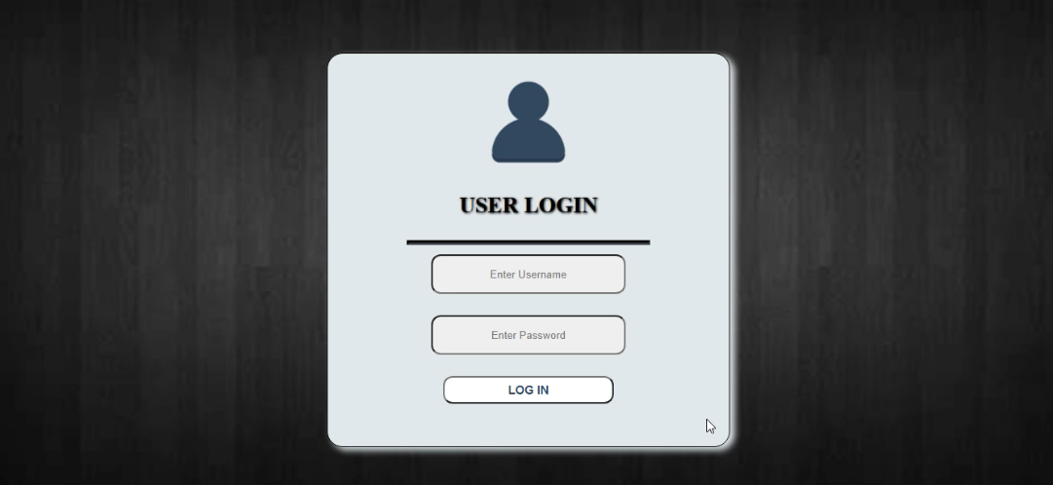
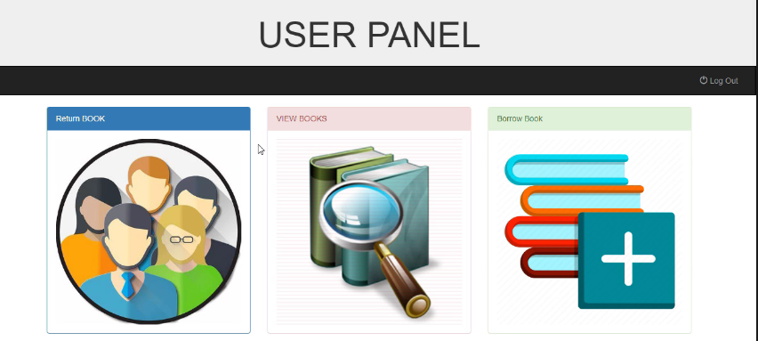
USER PAGE
USER LOGIN:
USER PROFILE:

Slide 10
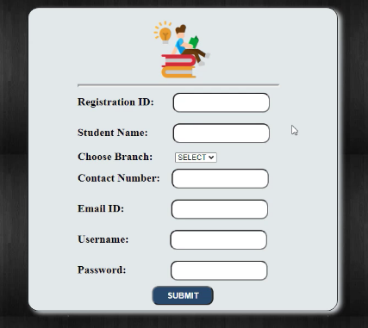
REGISTRATION PAGE

Slide 11
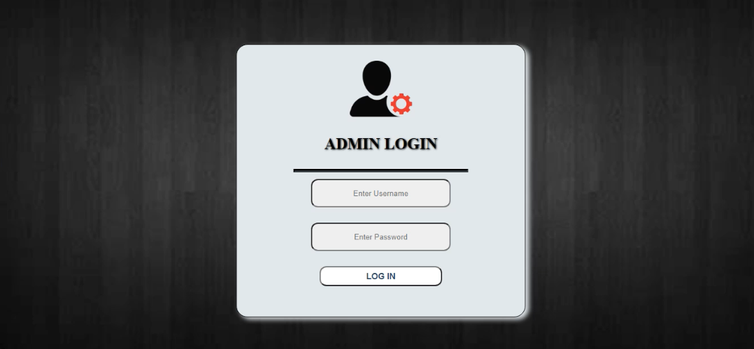
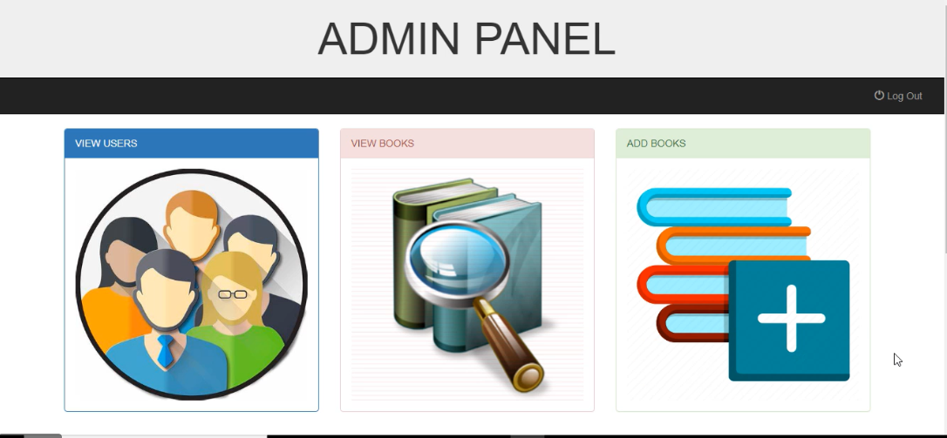
ADMIN PAGE
ADMIN LOGIN:
ADMIN PROFILE:

Slide 12
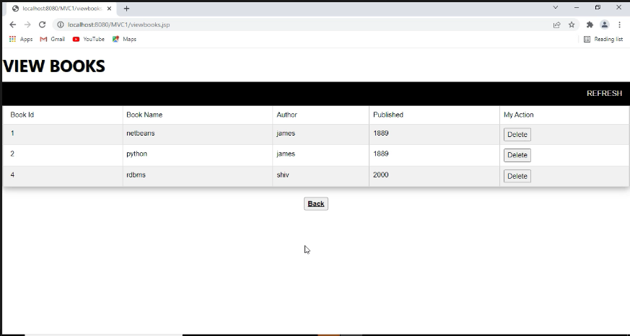
VIEW BOOKS

Slide 13
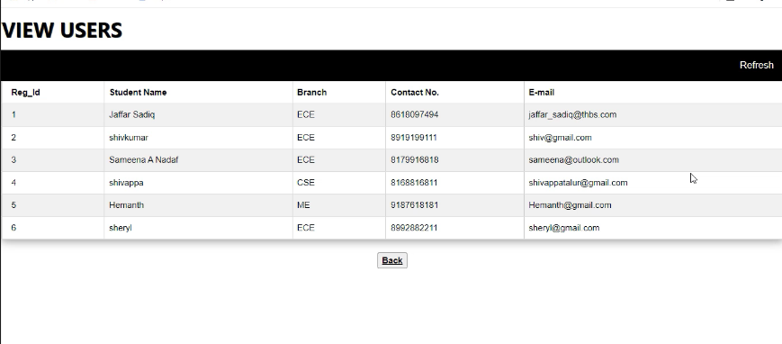
VIEW USERS

Slide 14
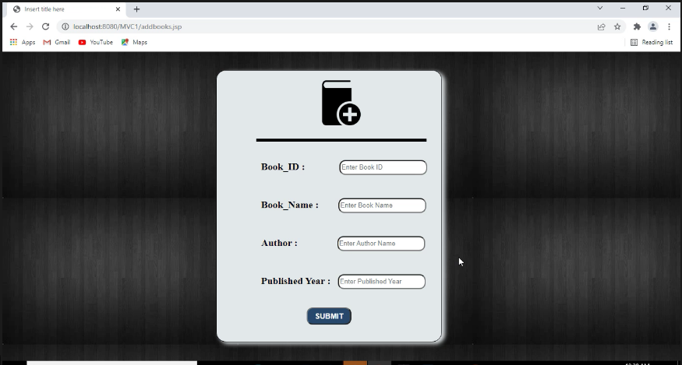
ADD BOOK

Slide 15
UPDATE BOOK

Slide 16
THANK YOU

